Slide 1


Slide 2

“Any hostility experienced from the world as a result of one’s identification as a Christian” –Open Doors USA
Research suggests that Christians in more than 65 countries face persecution from governments, neighbors, and even family members. Persecution comes in many forms — from hostile words and attitudes to physical torture and death. Each day Christians make the choice to endure this harsh treatment rather than turn from Jesus Christ.
“Any hostility experienced from the world as a result of one’s identification as a Christian” –Open Doors USA
Research suggests that Christians in more than 65 countries face persecution from governments, neighbors, and even family members. Persecution comes in many forms — from hostile words and attitudes to physical torture and death. Each day Christians make the choice to endure this harsh treatment rather than turn from Jesus Christ.

Slide 3
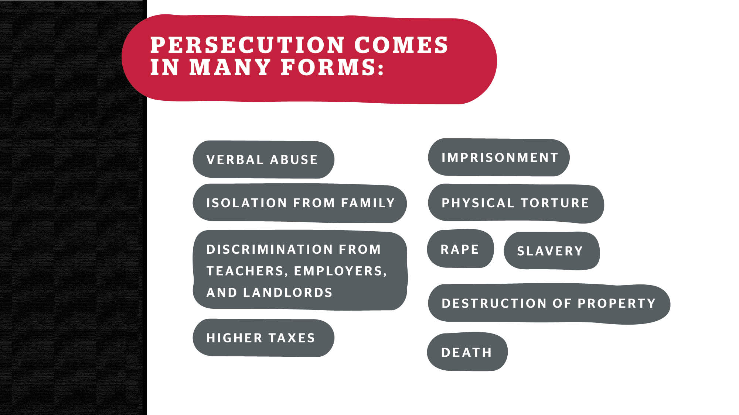

Slide 4
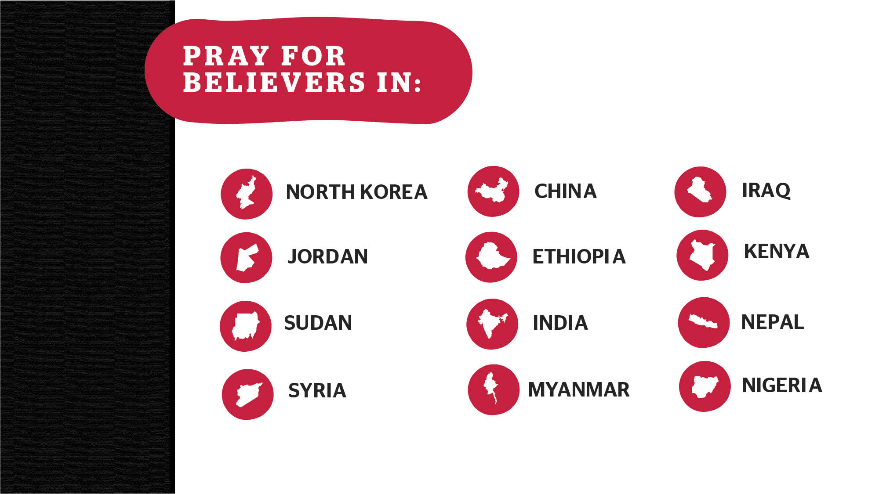

Slide 5

Being a Christian is forbidden by law here, and public expressions of faith or possession of Bibles can result
^{in execution.}
Approximately 70,000: The number of Christians imprisoned in labor camps

Slide 6

Muslim-background believers in Jordan face tremendous pressure to return to Islam, including discrimination, verbal abuse, and physical threats.
169,000: The number of Christians in a country of almost 8 million people

Slide 7

Nationalists have pushed for the cleansing of all other religions from the nation, driving many Christians into South Sudan
No. 4: Sudan’s ranking on the list of most dangerous places for Christians

Slide 8

Although ISIS has mostly been driven out of Syria, Christians still live in constant danger because of Islamic extremist groups.
5.6 million: The number of Syrians who have fled the country to escape violence

Slide 9

Christians who worship apart from government-approved churches are subject to discrimination and threats.
6.9 percent: The amount of China’s population that is Christian

Slide 10

Christians face violence and immense pressure from their peers to convert — either to an Orthodox tradition, Islam, or a more secular point of view.
50: The number of churches burned throughout Ethiopia in a single year

Slide 11

In this country, radical Hindus view Christians as blemishes to be removed, and a hostile atmosphere makes it difficult for believers to share their faith.
4.8 percent: The number of India’s population that is Christian

Slide 12

Christians in this nation face discrimination from their Buddhist nationalist neighbors as well as violence by groups of radical monks.
100,000: The number of Christians forced to flee into neighboring Malaysia

Slide 13

Many Christians forced to flee during the height of ISIS’ power are still refugees, and those who remain face tremendous discrimination from racial Muslims.
258,000: The number of Christians left in Iraq.
A few years ago, there were more than 1 million.

Slide 14

The Islamic militant group al-Shabab has harassed, beaten, kidnapped, and even killed dozens of Christians in recent years.
147: The number of people killed by al-Shabab during a campus shooting

Slide 15

Hindu extremists say they want to make the country “Christian-free” and persecute believers whom they view as a threat to their Nepali identity.
1.4 percent: Christ-followers make up this small percentage of the population

Slide 16

Boko Haram and the Fulani herdsmen, two militant Islamic groups, continue to terrorize Christians and have forced millions to flee their homes.
4,028: The number of Nigerian Christians martyred in
^{one year}

Slide 17

Count it all joy, my brothers, when you meet trials of various kinds, for you know that the testing of your faith produces steadfastness.
If one member suffers, all suffer together; if one member is honored, all rejoice together.

Slide 18
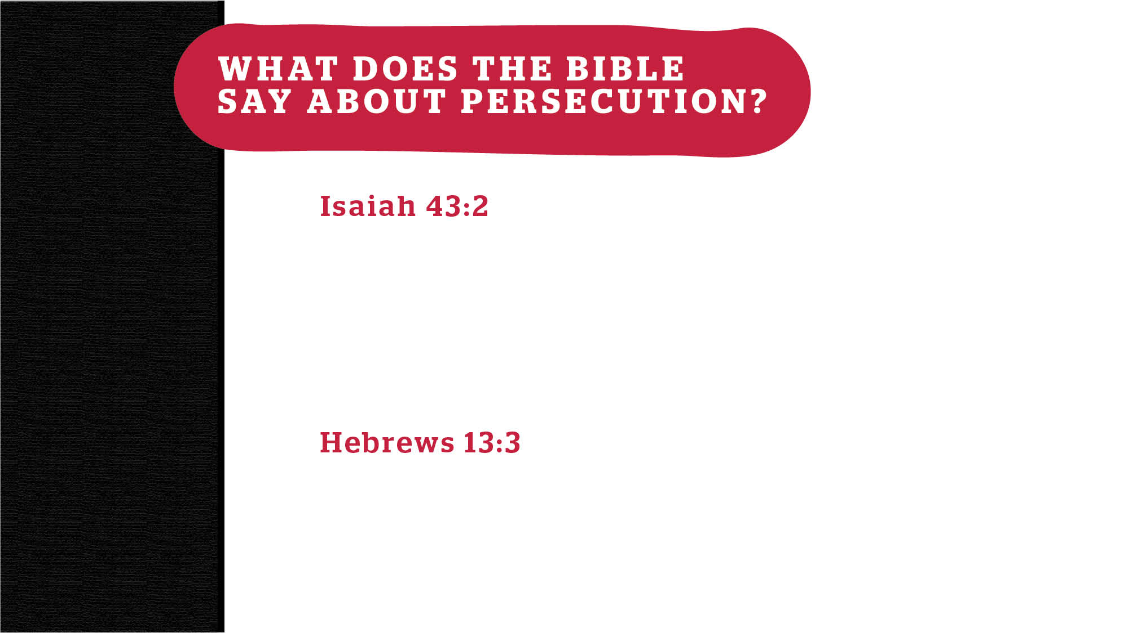
When you pass through the waters, I will be with you; and through the rivers, they shall not overwhelm you; when you walk through the fire, you shall not be burned, and the flame shall not consume you.
Remember those who are in prison, as though in prison with them, and those who are mistreated, since you are also in the body.

Slide 19

Intercede on behalf of fellow believers
Use your voice and social media to raise awareness about persecution
Your gift of $50 will help meet a persecuted Christian’s most critical needs such as medical care, food, relocation costs, legal assistance,
^{and more.}
Intercede on behalf of fellow believers
Use your voice and social media to raise awareness about persecution
Your gift of $50 will help meet a persecuted Christian’s most critical needs such as medical care, food, relocation costs, legal assistance,
^{and more.}
Visit internationaldayofprayer.com for more
information about how to get involved.
Visit internationaldayofprayer.com for more
information about how to get involved.
Notes:
Website may change

Slide 20

^{• Strength and courage}
• Opportunities for our brothers and sisters to share the Gospel
^{despite persecution}
• That those separated from their families will be reunited
• Comfort for those who have converted and been disowned
^{by family}
^{• Health and safety}
• That God will touch the hearts of oppressors
• That those displaced from their homes will be able to return
• That believers will forgive, love, and pray for their persecutors

Slide 21

• Teach kids about persecuted children around the world and how
^{to pray for them.}
• Fundraise within your church to meet the needs of persecuted
^{Christians}
• Organize prayer nights specifically for praying over the
^{persecuted church}

Slide 22

Read stories of persecuted believers and discover other
resources at internationaldayofprayer.com.
Notes:
Website may change

