Slide 1
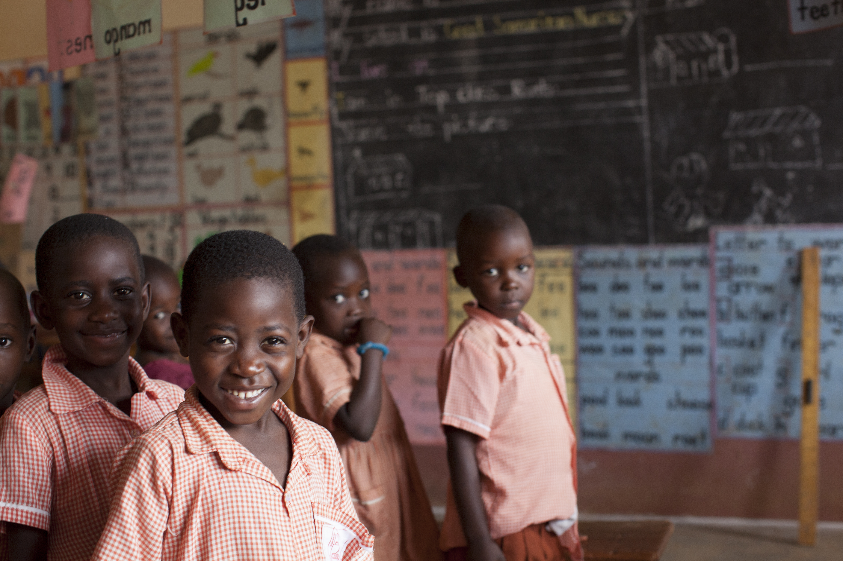

TODAY IS
ORPHAN
SUNDAY!
Show an orphan or
other child in need the
love of Christ through
child sponsorship.
Get started right now:
worldhelp.net/orphan

