Slide 1
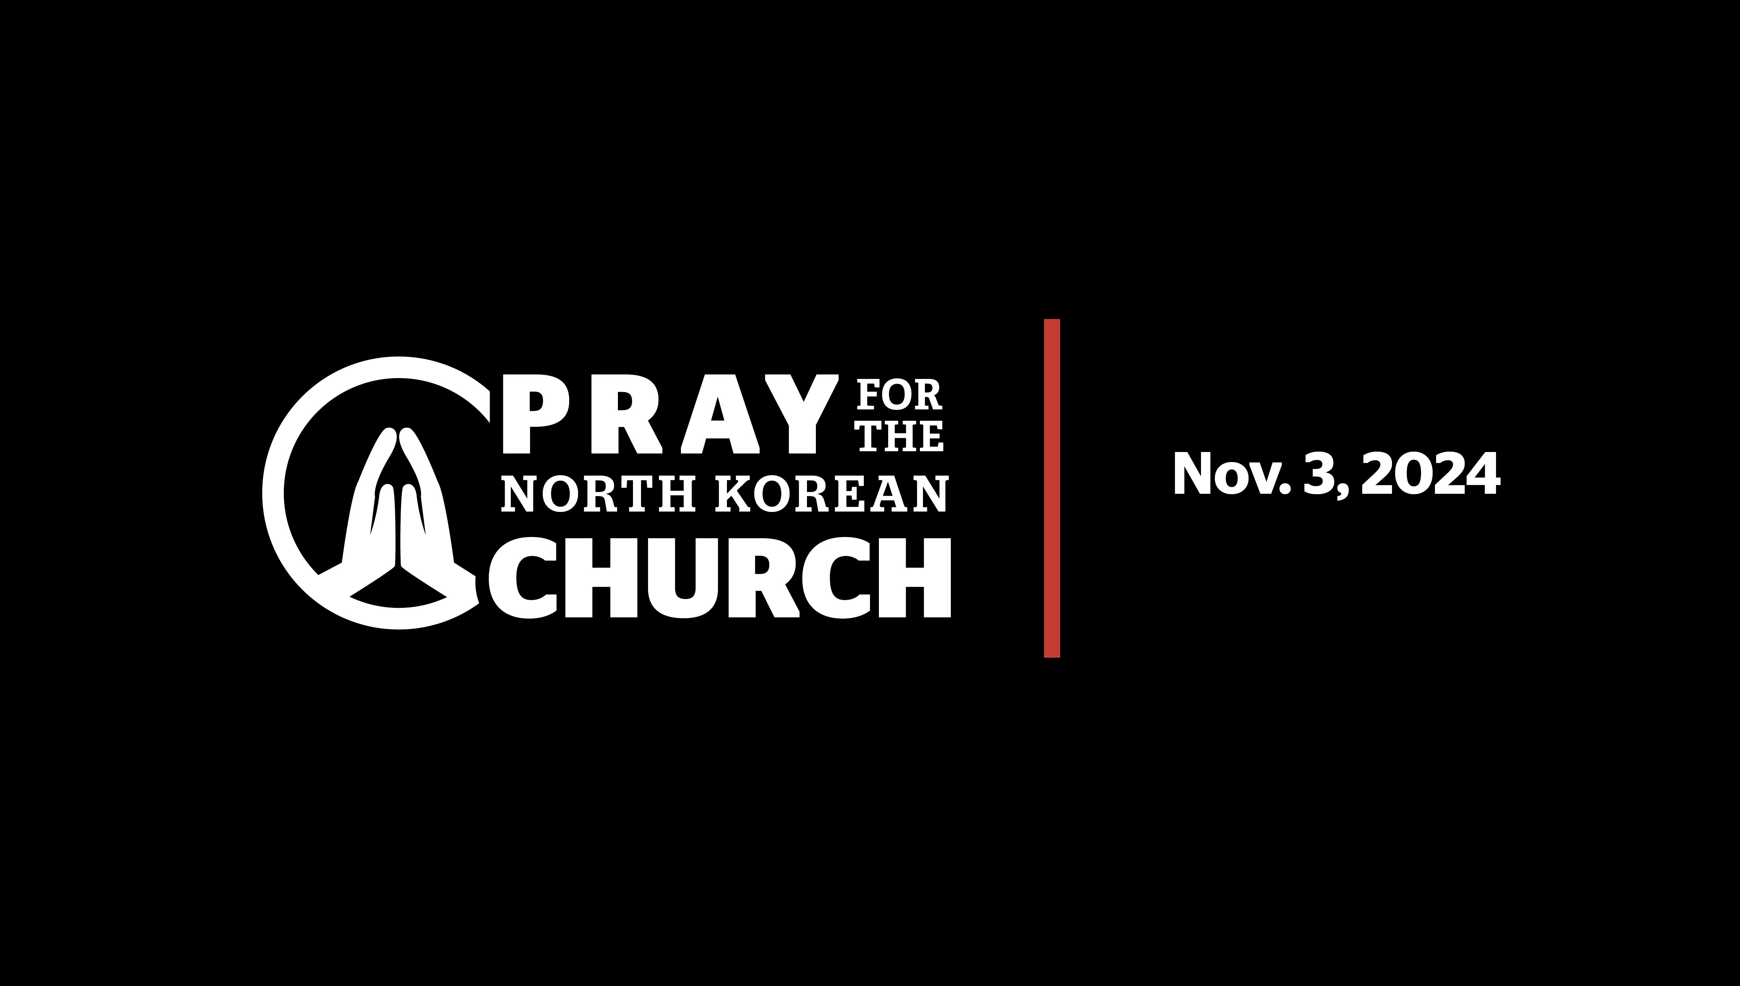

Slide 2

What is International Day of Prayer?
International Day of Prayer for the Persecuted Church is observed by churches around the world on the first Sunday in November. It’s a time set aside to pray for and help our brothers and sisters suffering for their faith.
This year, while we pray for persecuted Christians all around the globe, we are especially focusing on the needs of the North Korean underground church.

Slide 3
Why North Korea?
For years, North Korea has been ranked as the one of the most dangerous countries on earth for Christians.
Being a Christian is forbidden by law, and “crimes” like owning a Bible or telling someone about Jesus can result in a 15-year sentence in political labor camps. In some cases, believers are even executed on sight.
The average life expectancy for a Christian in one of these camps is just a few years … and many do not outlive their sentences.
An estimated 50,000 to 70,000 North Korean Christians are currently imprisoned for their faith.
“Any hostility experienced from the world as a result of one’s identification as a Christian” –Open Doors USA
Research suggests that Christians in more than 65 countries face persecution from governments, neighbors, and even family members. Persecution comes in many forms — from hostile words and attitudes to physical torture and death. Each day Christians make the choice to endure this harsh treatment rather than turn from Jesus Christ.

Slide 4
What’s the good news?
“Any hostility experienced from the world as a result of one’s identification as a Christian” –Open Doors USA
Research suggests that Christians in more than 65 countries face persecution from governments, neighbors, and even family members. Persecution comes in many forms — from hostile words and attitudes to physical torture and death. Each day Christians make the choice to endure this harsh treatment rather than turn from Jesus Christ.
Despite persecution, the North Korean church is growing. In fact, it’s now estimated that there are around 400,000 underground believers — even more than religious organizations had previously estimated!

Slide 5
What are their greatest needs?
“Any hostility experienced from the world as a result of one’s identification as a Christian” –Open Doors USA
Research suggests that Christians in more than 65 countries face persecution from governments, neighbors, and even family members. Persecution comes in many forms — from hostile words and attitudes to physical torture and death. Each day Christians make the choice to endure this harsh treatment rather than turn from Jesus Christ.
^{BIBLES}
Even with the risks, North Korean Christians are begging for Bibles.
The underground church is growing so quickly, there aren’t enough Bibles to keep up!
Many underground churches have only a few hand-copied verses to read from.

Slide 6
What are their greatest needs? (continued)
“Any hostility experienced from the world as a result of one’s identification as a Christian” –Open Doors USA
Research suggests that Christians in more than 65 countries face persecution from governments, neighbors, and even family members. Persecution comes in many forms — from hostile words and attitudes to physical torture and death. Each day Christians make the choice to endure this harsh treatment rather than turn from Jesus Christ.
^{FOOD}
Additionally, North Koreans are facing a historic food shortage.
Major flooding in North Korea has destroyed thousands upon thousands of acres of crucial crops. This is due to poor drainage, deforestation, and neglected infrastructure.
The flooding comes after several years of food shortages caused by the pandemic — North Koreans have yet to experience relief, and the need for food is only getting more urgent as the shortage persists.

Slide 7
What should I pray for?
Strength and courage for our persecuted brothers and sisters
Opportunities for them to share the Gospel despite persecution
Protection for those imprisoned in labor camps
That God will touch the hearts of oppressors
That Christians will forgive, love, and pray for their persecutors
That people will receive the food they need to survive North Korea’s famine
That Christians and Christ-seekers will receive the Bibles they need to continue growing in their faith
“Any hostility experienced from the world as a result of one’s identification as a Christian” –Open Doors USA
Research suggests that Christians in more than 65 countries face persecution from governments, neighbors, and even family members. Persecution comes in many forms — from hostile words and attitudes to physical torture and death. Each day Christians make the choice to endure this harsh treatment rather than turn from Jesus Christ.

Slide 8
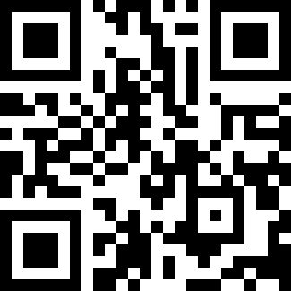
How else can I help?
“Any hostility experienced from the world as a result of one’s identification as a Christian” –Open Doors USA
Research suggests that Christians in more than 65 countries face persecution from governments, neighbors, and even family members. Persecution comes in many forms — from hostile words and attitudes to physical torture and death. Each day Christians make the choice to endure this harsh treatment rather than turn from Jesus Christ.
Your gift of $20 will provide a week’s worth of lifesaving food and a Bible for one persecuted North Korean Christian.
Learn more and give at worldhelp.net/prayer

